Slide 1

Efficient Neural Nets for V2X Sequential Dynamic User Allocation
Ha Manh Bui

Slide 2
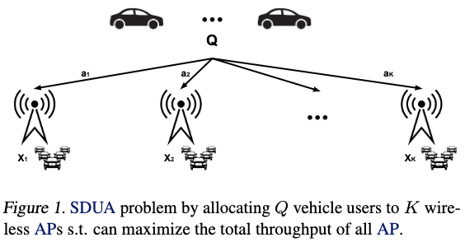

Problem and motivation
Vehicle-to-everything (V2X) Sequential Dynamic User Allocation (SDUA) problem (Gupta et al., 2022): K wireless Access Point (AP)s, at each round (time), there are X unknown existing users, we need to allocate Q new incoming vehicle users to K APs by action vector a s.t. can maximize the total throughput of all AP, i.e.,
Note:
Each user has a fixed traffic load of 0.2 and consider the ALOHA protocol (Abramson, 1970) for each AP.
Assume all the users of an AP will leave when the round ends, so a in the current round will not affect X in the future rounds (Gupta et al., 2022).

Slide 3
Problem and motivation
Vehicle-to-everything (V2X) Sequential Dynamic User Allocation (SDUA) problem (Gupta et al., 2022): K wireless Access Point (AP)s, at each round (time), there are X unknown existing users, we need to allocate Q new incoming vehicle users to K APs by action vector a s.t. can maximize the total throughput of all AP, i.e.,
Gupta et al. (2022) formalized under Combinatorial Multi-Armed Bandit (CMAB) and solved with classical algorithms (greedy, Combinatorial Upper Confidence Bound-Resource Allocation (CUCB-RA)), but they still have a low allocation quality
Recently, Neural Combinatorial Bandits (NCB) (Hwang et al., 2023) has shown promising results, but needs to re-optimize a Neural Net with all of the cumulative training data, causing a high response latency

Slide 4
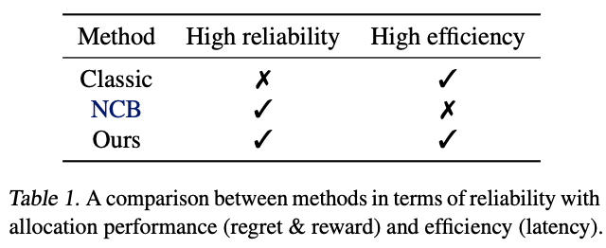
Problem and motivation
Vehicle-to-everything (V2X) Sequential Dynamic User Allocation (SDUA) problem (Gupta et al., 2022): K wireless Access Point (AP)s, at each round (time), there are X unknown existing users, we need to allocate Q new incoming vehicle users to K APs by action vector a s.t. can maximize the total throughput of all AP, i.e.,
Gupta et al. (2022) formalized under Combinatorial Multi-Armed Bandit (CMAB) and solved with classical algorithms (greedy, Combinatorial Upper Confidence Bound-Resource Allocation (CUCB-RA)), but they still have a low allocation quality
Recently, Neural Combinatorial Bandits (NCB) (Hwang et al., 2023) has shown promising results, but needs to re-optimize a Neural Net with all of the cumulative training data, causing a high response latency
In this project:
We reimplement the SDUA experiment in Gupta et al. (2022), and we additionally show the result of NCB (Hwang et al., 2023) in this setting
We show NCB is not efficient, and we propose an efficient algorithm that can achieve ultra-low latency performance in V2X
We empirically show our proposed method has a competitive result with NCB in allocation performance, and outperforms them in terms of efficiency

Slide 5
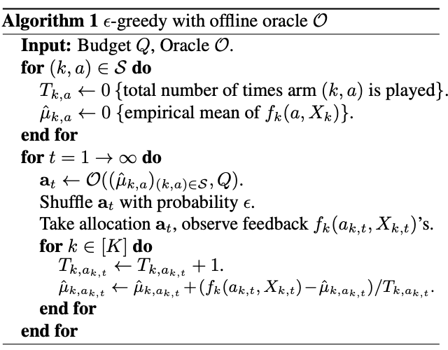
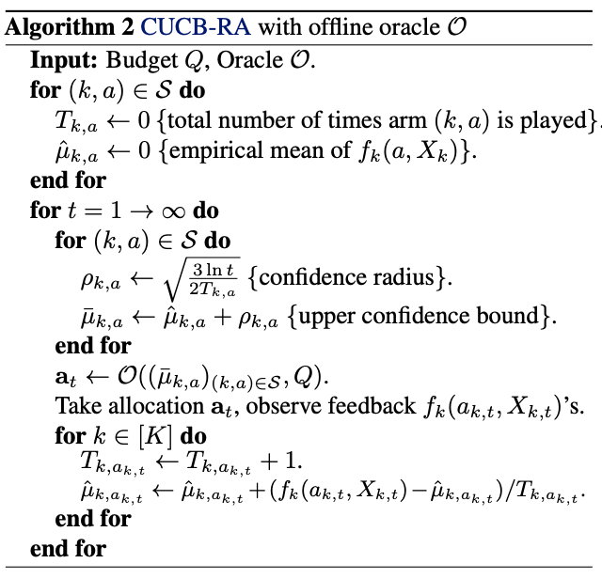
Methods
Classical methods (Gupta et al., 2022): select the best allocation strategy by
Greedy (Sutton & Barto, 2018): use the empirical mean of the reward function (the objective function we optimize)
CUCB-RA (Chen et al., 2013): use the empirical mean of the reward function + confidence intervals of #times played
Pros: Fast by do not need to optimize anything
Cons: The allocation quality is still low

Slide 6
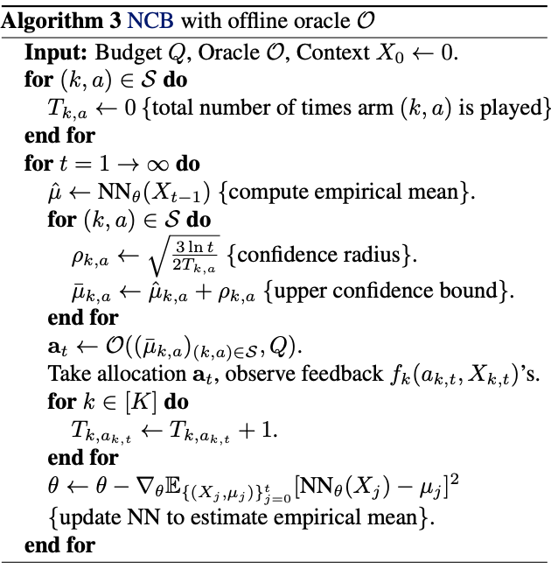
Methods
Neural Combinatorial Bandits (NCB) (Hwang et al., 2023):
Use a Neural Network to map from previous context to approximate directly the empirical mean of reward function
Then, after every step t, it updates model based on cumulative data by using Stochastic Gradient Descent with Mean Square Error (Sutton & Barto, 2018)
Pros: Improve the allocation quality
Cons: Slow by need to optimize on cumulative data

Slide 7
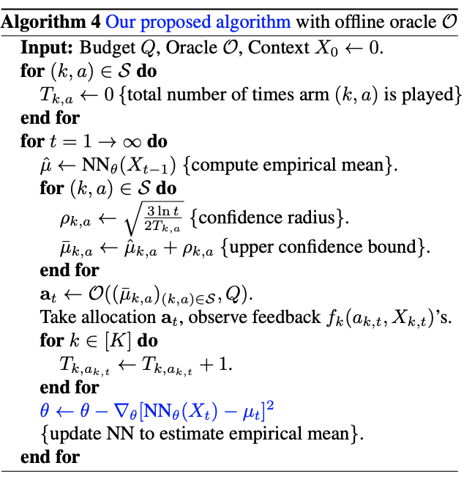
Methods
Our proposed method:
Similar to NCB, but only update with the model with the latest data
Pros:
Keep high allocation quality of NCB
Reduce latency of NCB
=> Balance allocation performance and efficiency

Slide 8
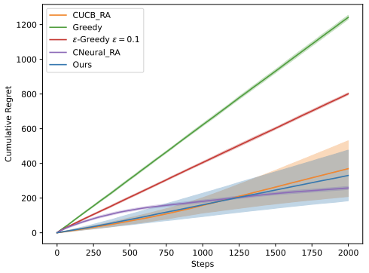
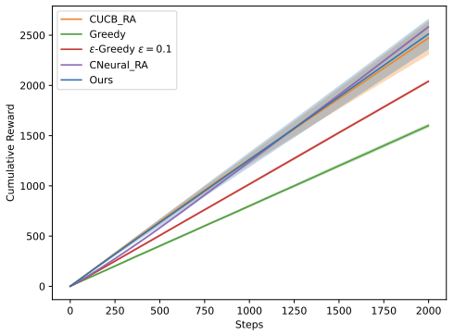
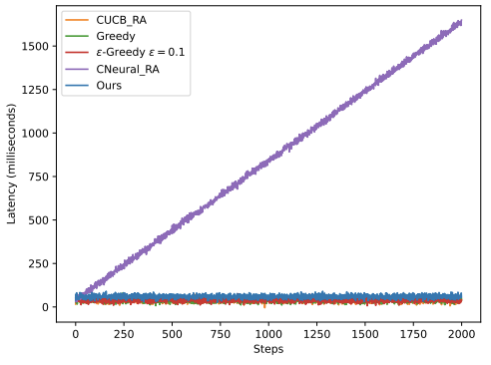
Experiments
Cumulative regret
Cumulative reward
Latency (ms)
Dataset: We use the RF Jamming Dataset for Vehicular Wireless Networks (Pajevic et al., 2022): Q = 8, K = 4 APs, i.e., {91, 92, 94, 95} on the 3-rd floor of Building 3 on campus, and record their associated users from 13:00 to 16:00 on March 2, 2015
Observation after T = 2000 steps:
NCB outperforms classical methods when the step increases by having a lower regret (optimal value - predicted value) and higher reward
Our proposed approach has a competitive result with NCB in terms of allocation performance
Our method has a much lower latency than NCB, and almost as efficient as classic algorithms

Slide 9
Summary
We study the Vehicle-to-everything (V2X) Sequential Dynamic User Allocation problem, i.e., how to allocate new vehicles to multiple wireless Access Point (AP)s s.t. can maximize the total throughput of all AP
We reimplement the SDUA experiment in Gupta et al. (2022), and we additionally shows the result of NCB (Hwang et al., 2023) in this setting
We show NCB is not efficient, and we propose an efficient algorithm that can achieve the ultra-low latency performance in V2X
We empirically show our proposed method has a competitive result with NCB in allocation performance, and outperforms them in terms of efficiency
Thank you for your attention!

Slide 10
References
Gupta, S., Zuo, J., Joe-Wong, C., Joshi, G., and Yagan, ˘ O. Correlated combinatorial bandits for online resource allocation. In Proceedings of the Twenty-Third International Symposium on Theory, Algorithmic Foundations, and Protocol Design for Mobile Networks and Mobile Computing, 2022.
Hwang, T., Chai, K., and Oh, M.-H. Combinatorial neural bandits. In Proceedings of the 40th International Conference on Machine Learning, 2023.
Pajevic, L., Karlsson, G., and Fodor, V. Crawdad kth/campus, 2022. URL https://ieee-dataport. org/collections/crawdad.
Abramson, N. The aloha system: Another alternative for computer communications. In Proceedings of the November 17-19, 1970, Fall Joint Computer Conference. Association for Computing Machinery, 1970.
Sutton, R. S. and Barto, A. G. Reinforcement Learning: An Introduction. The MIT Press, second edition, 2018.
Chen, W., Wang, Y., and Yuan, Y. Combinatorial multiarmed bandit: General framework and applications. In Proceedings of the 30th International Conference on Machine Learning, 2013.

